Slide 1

(ETCS-403)

Slide 2
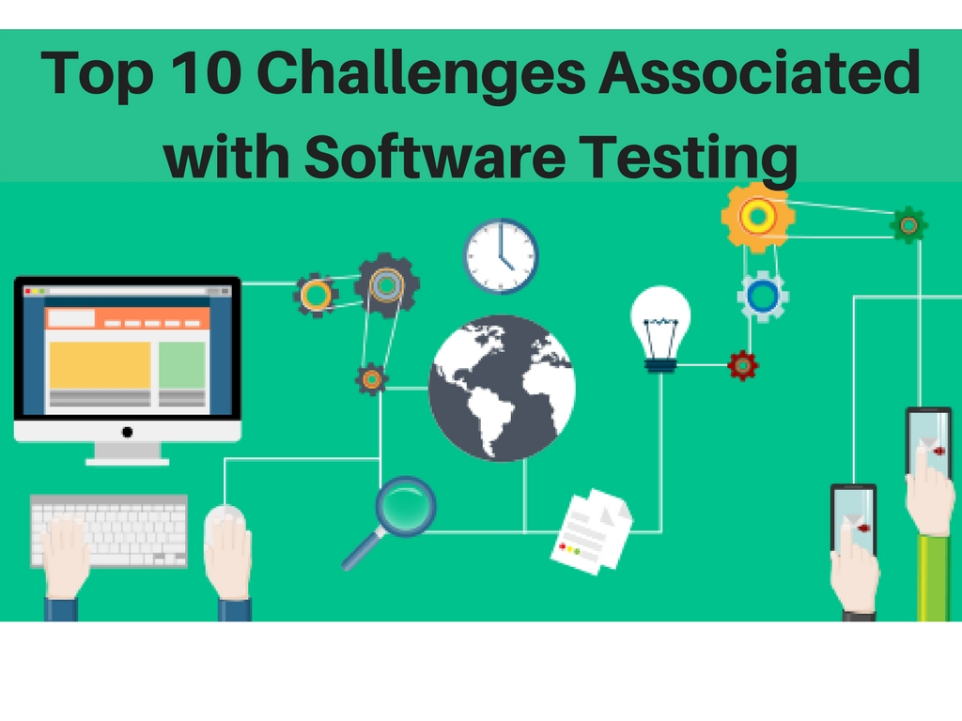

Slide 3
Testing the whole application:
It is extremely difficult to test each and every combination both in manual and in automation testing as there are millions of test combinations.
Tight schedules:
There are times when you have to work way more than the actual working hours to conclude the task.( tasks include writing, executing, automating, and reviewing the test cases.)
To deliver the right product at the right time, time management is crucial.
Lack of skilled testers:
It is important to hire skilled resources as unskilled fellows may add more confusion than streamlining the testing work.
This can result in an insufficient, incomplete, and ad-hoc testing all through the testing life cycle.

Slide 4
Regression testing:
When the project is on the verge of expansion, the regression testing work becomes uninhibited. Pressure to withstand the existing functionality changes the earlier working bug tracking and functionality checks.
Understanding the requirements:
Sometimes the testers fail to understand the exact requirements of the clients as a tester is the only one responsible for communicating with the customers. Testers with good listening skills can understand the requirements properly and fulfill the exact requirement.
Automation testing:
Automation is one of the most important areas where we can reduce the execution time and can perform regression testing after performing any kind of changes to the code. Whereas, in web applications, the creation of test scripts and using them is more stimulating than for other applications.

Slide 5
Compatibility:
These days it is usual to see the client asking for the web application that has to work in Windows OS to Mac OS, from Internet Explorer to Safari browsers, from a Web browser to Mobiles. This has made testing even more challenging than before.
Data integrity:
The most susceptible area in the software business is the collection and storage of highly valuable customer data. Lest the data stored is accurate and correct, the business may run into predicaments.
Re-usability of test design:
More reusable components have to be deployed for any project if the project life cycle time gets interrupted. Though in web applications since every project varies in all aspects of requirements, the possibility for re-usability is limited.

Slide 6
Time is always a big constraint:
Tester simply focuses on the task completion rather than test coverage and quality of work when the time is less.
A huge list of tasks is there to be completed within specified time while completing the task within a specified time-frame which includes writing, executing, automating, and finally reviewing the test cases.

Slide 7
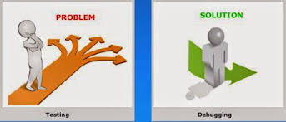
Testing Vs Debugging

Slide 8
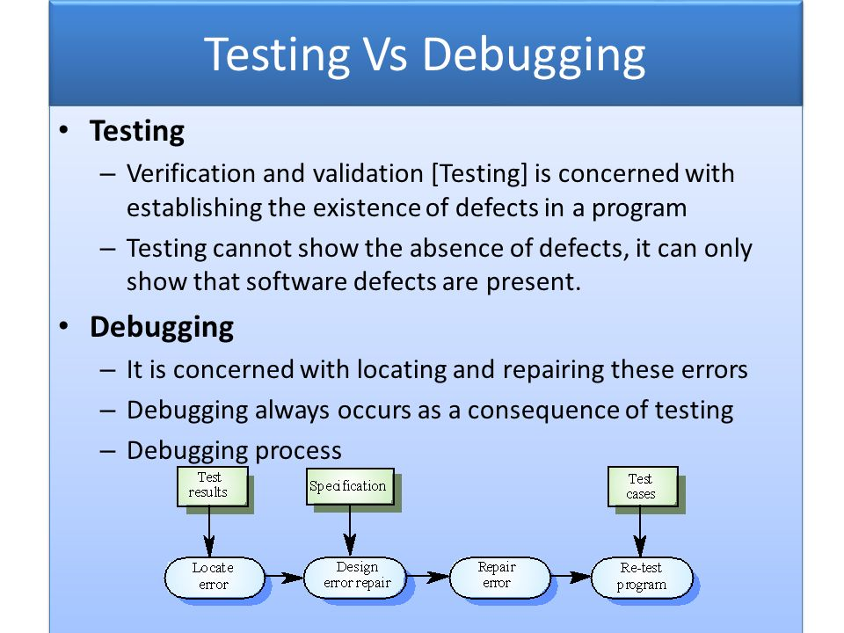

Slide 9
Testing | Debugging
Performed by testers | Performed by developer or development team
Can be done manually or automatically | Can only be done manually
Can be predefined when starting testing. The test result could be predicted | Start with unknown conditions and it is hard to predict the result
Find the programming failure | Demonstrate that it’s only an unattended small mistake
Could be done automatically by using automated testing tools | Automatic debugging of software is still a dream of programmers
The purpose is to find the bug | The purpose is to find the cause of a bug

Slide 10
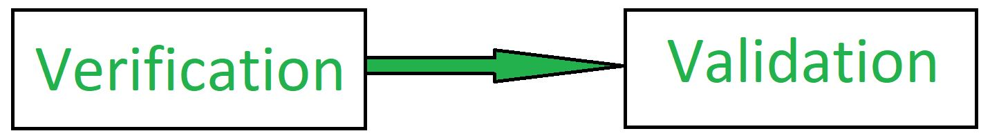
Verification and Validation
erification is followed by Validation.
Barry Boehm described verification and validation as the following:
Verification: Are we building the product, right? Validation: Are we building the right product?

Slide 11
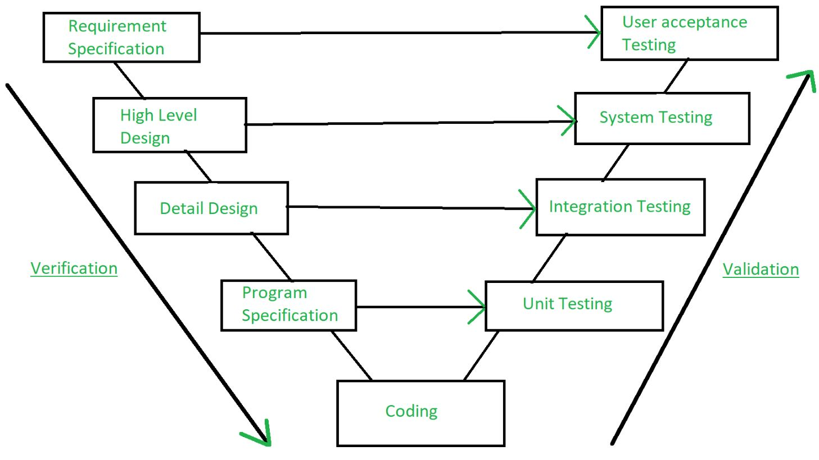

Slide 12
Verification
Verification is the process of checking that a software achieves its goal without any bug
Verification is Static Testing.
Activities involved in verification:
Inspections
Reviews
Walkthroughs
Desk-checking

Slide 13
Validation
Validation is the process of checking whether the software product is up to the mark or in other words product has high level requirements
Validation is the Dynamic Testing.
Activities involved in validation:
Black box testing
White box testing
Unit testing
Integration testing

Slide 14
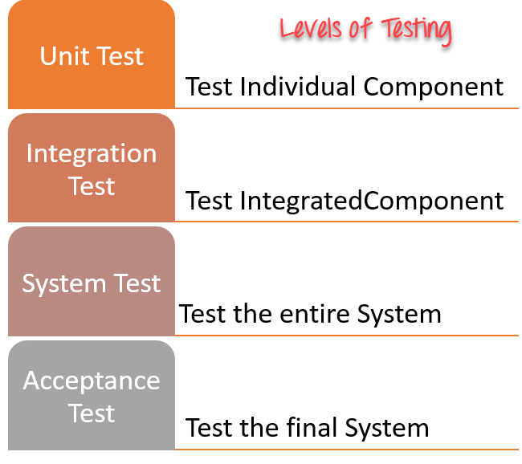
Test Levels A level of software testing is a process where every unit or component of a software/system is tested.

Slide 15
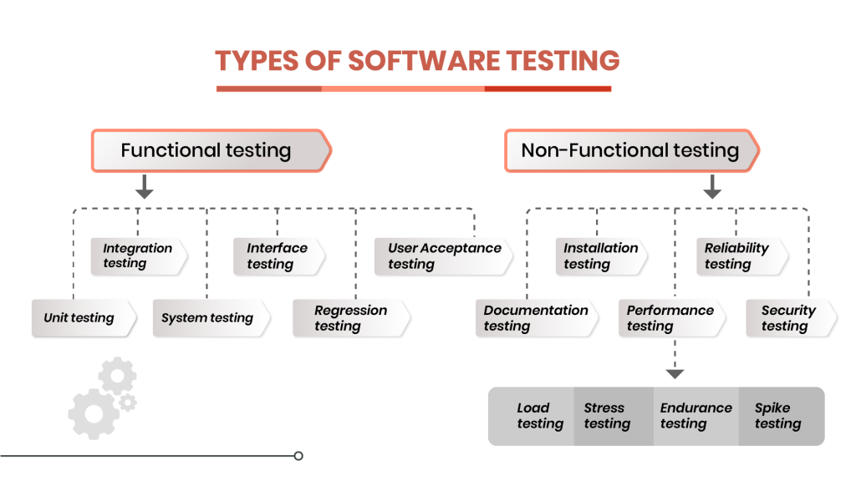
Types of software Testing

Slide 16
Ques1:What is a test case?
A test case is nothing but a set of conditions or variables under which a tester will determine whether a system under test satisfies requirements or works correctly.
Ques2:On what basis the acceptance plan is prepared?
Basically, the acceptance document is prepared using the following inputs.
Requirement document: It specifies what exactly is needed in the project from the customers perspective.
Input from the customer: This can be discussions, informal talks, emails, etc.
Project plan: The project plan prepared by the project manager also serves as good input to finalize your acceptance test.

